Slide 1
Contents
1: Introduction of the project.
2: Data collection
3: Objectives & KPI’s
4: Analysis of the project
5: Recommendations of the project
6: Conclusion
7: Dashboards

Slide 2
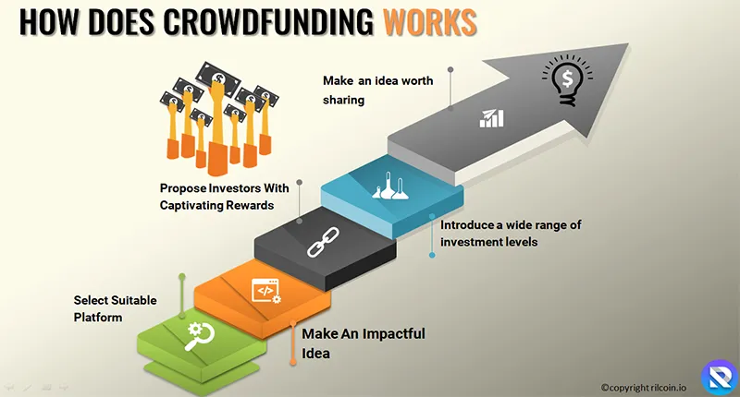
Introduction of the project
Crowdfunding is basically a process of collecting a huge part of the crowd to pay a certain amount of money to invest in an idea/product. The investors invest in such ideas by keeping the promise that when the idea gets success, they will be getting first access to it. The main motto of crowdfunding is to engage enough crowd with your upcoming project and getting necessary funds.

Slide 3

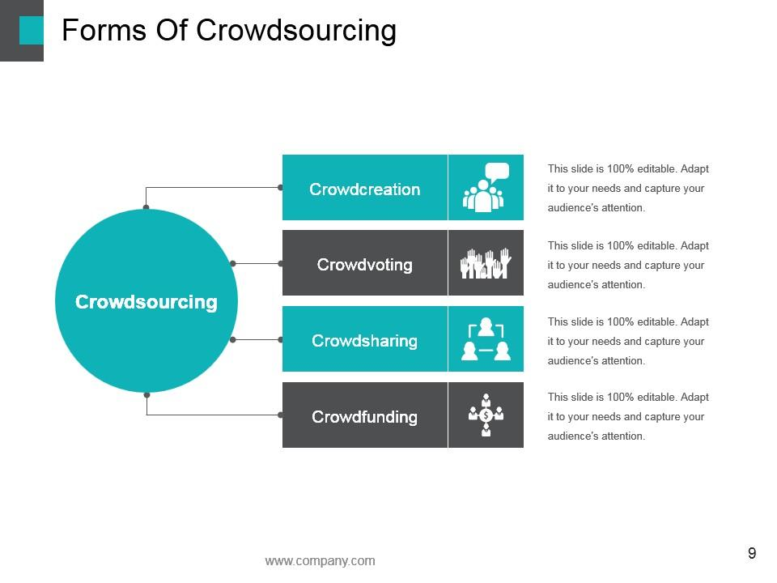
Data Collection
1: Extract data from platform web pages.
2:Use APIs to gather detailed project data with authorization.
3: Cleaning
Address missing values and outliers.
4: Transforming
Convert data types and create new Features
5: Validating
Ensure data accuracy and consistency.

Slide 4
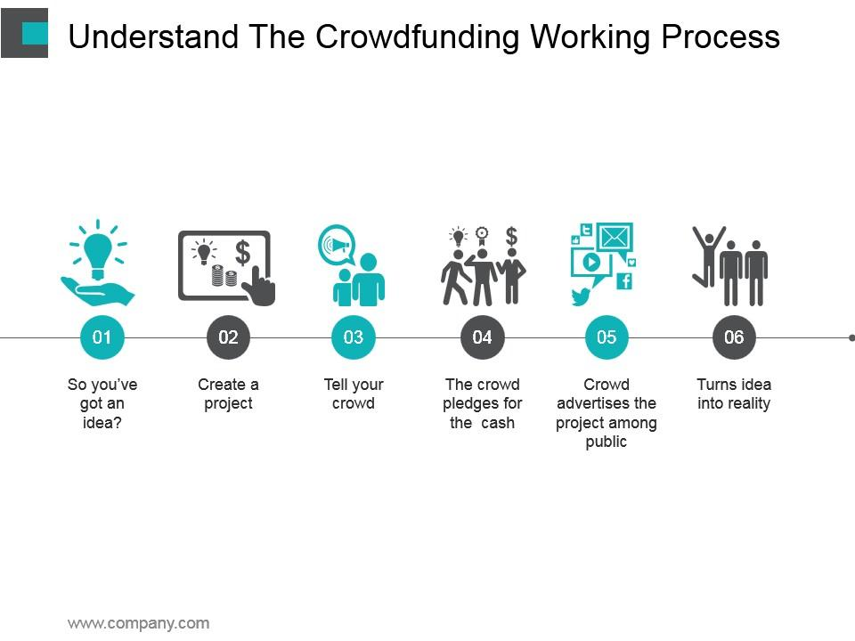
Objective’s & KPI’s
1: Funding Goal Achievement:
Total Funds Raised: Measures how much money the campaign has raised compared to the set goal. It shows if the crowdfunding effort is on track for success.
2: Backer Engagement:
Number of Backers: The total number of people who have pledged to the campaign. This shows the level of interest in your project.
3: Campaign Traffic and Reach:
Website Traffic: The number of visitors to the crowdfunding campaign page or associated website. A higher traffic volume often correlates with a more successful campaign.
4: Marketing Effectiveness:
Email Open Rate and Click-through Rate (CTR): The percentage of recipients who open your campaign emails and take action by clicking on the links.
5: Timeline Adherence:
Campaign Duration and Timing: Measures if the project is on schedule regarding its launch and expected end date.

Slide 5

Analysis of the project
1:Concept & Purpose
Idea and Goals: Crowdfunding is the practice of raising small amounts of money from a large number of people, typically through online platforms. The purpose could be to fund a creative project, a business, a social cause, or a startup.
2: Types of Crowdfunding
Reward-based Crowdfunding: Contributors receive a reward or product in return for their support (e.g., Kickstarter).
Equity Crowdfunding: Investors receive equity or shares in the business in return for their funding (e.g., Crowdcube).
Donation-based Crowdfunding: Individuals donate money without expecting anything in return (e.g., GoFundMe).
Debt-based Crowdfunding (Peer-to-Peer Lending): Investors lend money to be repaid with interest (e.g., LendingClub).
3: Platform Selection
Choosing the right crowdfunding platform is crucial. The platform should align with the type of project, target audience, and the geographical scope of the project.

Slide 6
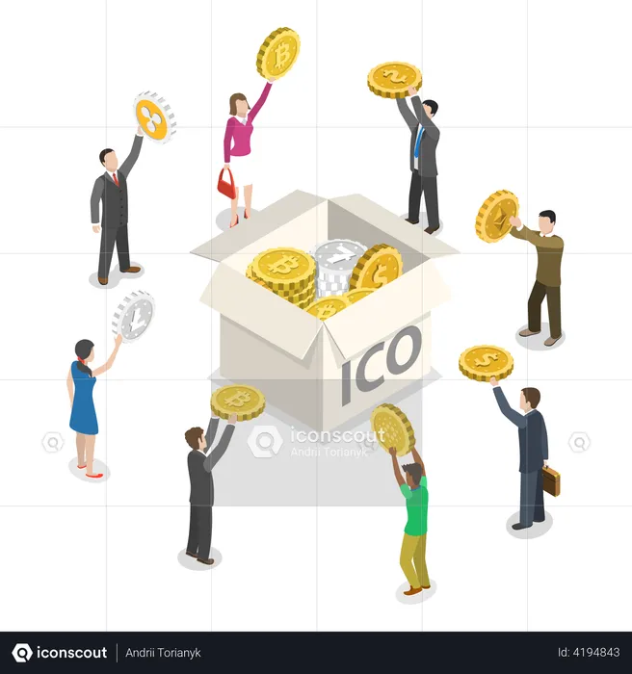
Recommendations of the Project
1: Create a Strong and Clear Value Proposition
2: Build a Compelling Story
3: Set Realistic Funding Goals
4: Develop a Strong Marketing Strategy
5: Offer Attractive and Tangible Rewards
6: Engage with Your Backers Regularly
7: Leverage Social Proof
8: Focus on Timing
Recommendations

Slide 7
Conclusion
In conclusion, crowdfunding presents a powerful opportunity for individuals and businesses to raise capital, engage with a community of supporters, and bring innovative ideas to life. By leveraging online platforms, project creators can connect with a diverse audience, share their vision, and gain the necessary funds to achieve their goals. However, success in crowdfunding depends on careful planning, effective marketing, and building trust with backers. When executed well, crowdfunding can not only provide financial support but also help establish a loyal and enthusiastic community around a project.

Slide 8
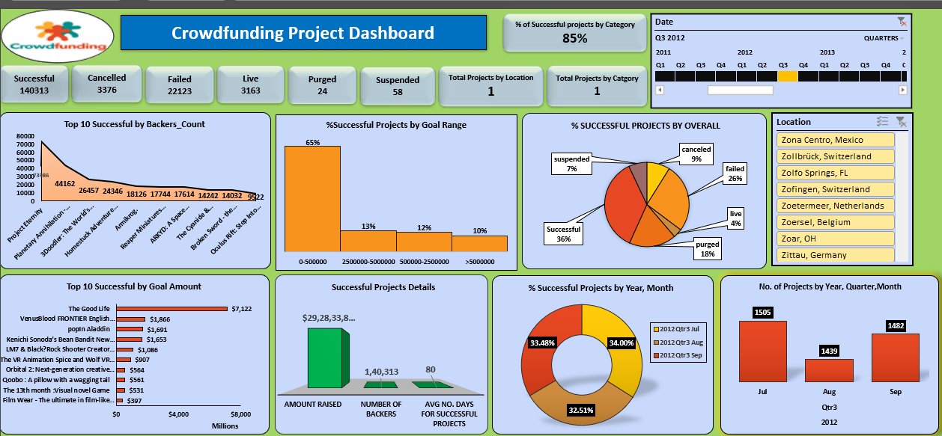
Dashboards
Excel Dashboard

Slide 9
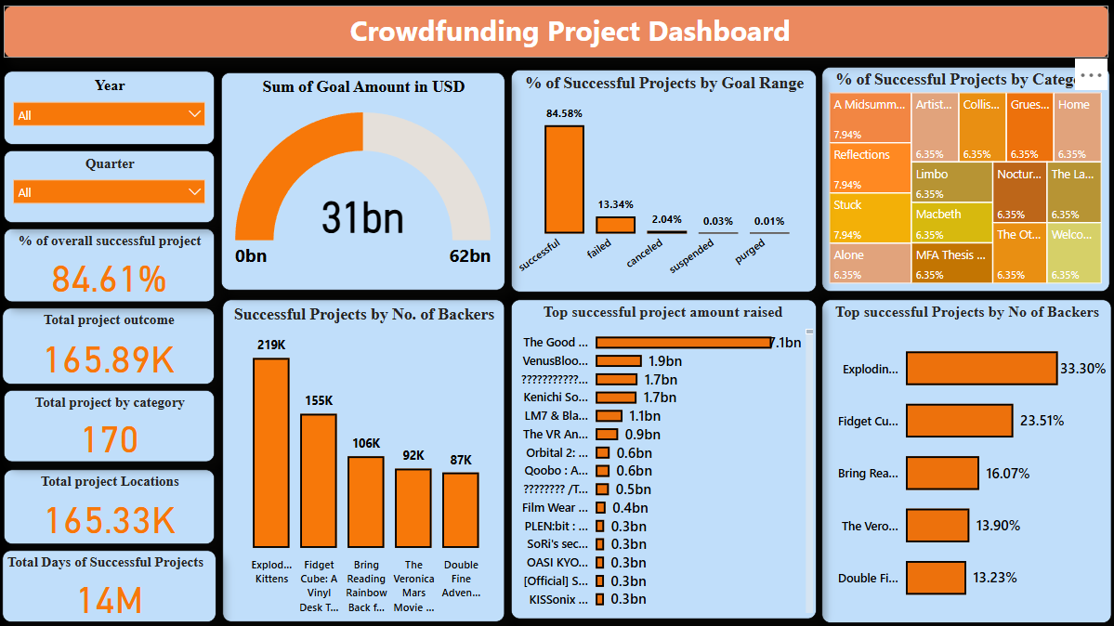
Power BI dashboard

Slide 10
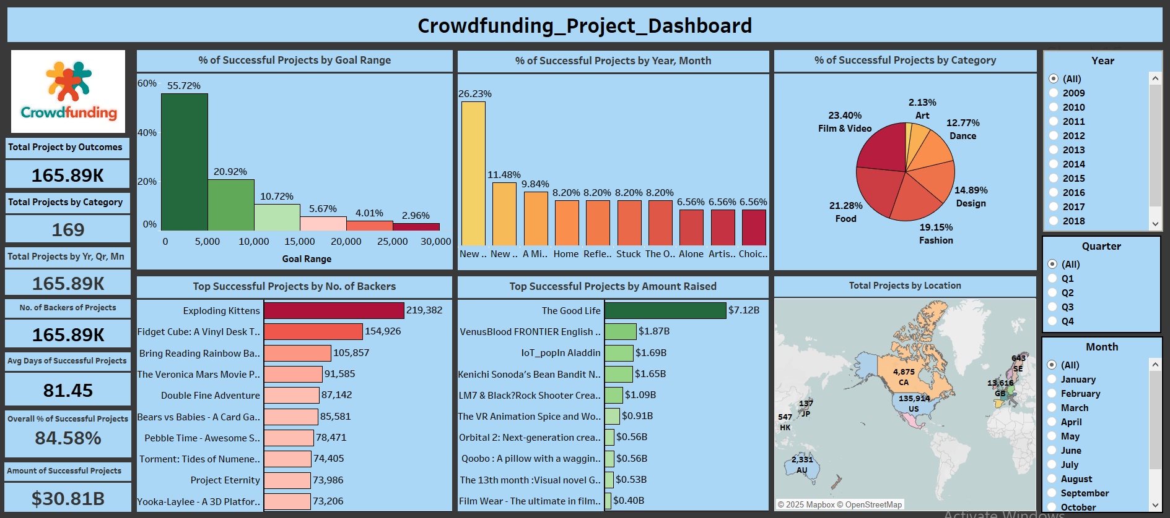
Tableau Dashboard

